Slide 1


Dr. N.G.P. INSTITUTE OF TECHNOLOGY
Coimbatore - 48
(An Autonomous Institution)
(Approved by AICTE, New Delhi & Affiliated to Anna University, Chennai
Recognized by UGC & Accredited by NAAC A+ and NBA (CSE, BME, EEE, ECE and Mech) Dr.N.G.P. Nagar, Kalapatti Main Rd, Coimbatore, Tamil Nadu 641048
Ph No: 0422 - 236 9105, Fax: 04222369106, E-mail: info@drngpit.ac.in
DEPARTMENT OF INFORMATION TECHNOLOGY
22UIT404- MINI PROJECT-I
CardioCare: Machine Learning for Health Care
Guided By
Dr.B.HEMALATHA
ASP/IT
Team Members
MADHU MITHA S (710723205037)
PREETHA J (710723205045)
SUJIKA S (710723205058)
THIRUNAAVUKKARASU S (710723205060)
BAARGAVAN A (710723205302)

Slide 2
OUTLINE
Introduction
Problem Statement
Objective
Literature Survey
Findings from Literature Survey
Existing System
Drawbacks of the Existing System
Proposed Methodology
Advantages of the Proposed Methodology
Hardware & Software Specifications
List of Modules with Descriptions
Result & Discussion
Conclusion & Future work
References

Slide 3

INTRODUCTION
Heart disease continues to rank among the world's leading causes of death.Prompt and precise forecasting is essential for prompt medical action.
Machine learning methods are used in this research to categorize and forecast cardiac illness, with the Support Vector Machine (SVM) being optimized for improved performance using the Jellyfish Optimization Algorithm.

Slide 4

PROBLEM STATEMENT
Unbalanced datasets and incorrect hyperparameter tuning frequently cause traditional models for heart disease prediction to perform ineffectively. A dependable, efficient system that can improve prediction accuracy is required.

Slide 5

OBJECTIVE
The goal is to use machine learning to create a prediction model for heart disease that is accurate. The Jellyfish Optimization Algorithm is used for SVM hyperparameter tweaking, feature selection, and data balance with SMOTE.

Slide 6
LITERATURE SURVEY
S.No. | Title of the Paper | Author Details | Publication & Year | Remarks
01. | Heart Disease Prediction Using Hybrid Machine Learning | Ahmed, Mohammed and Idress Husien | Journal of Robotics and Control (JRC) 5, no. 3 & 2024 | By merging several models, the study uses ensemble learning to forecast cardiovascular disease with higher accuracy. In order to train multiple models on large datasets, ensemble methods require more resources and are computationally costly and time-consuming.
02. | Improving Cardiovascular Disease Prediction through Comparative Analysis of Machine Learning Models | Anjum, Nishat, Cynthia Ummay Siddiqua, Mahfuz Haider, Zannatun Ferdus, Md Azad Hossain Raju, Touhid Imam, and Md Rezwanur Rahman | International Conference on Advance Computing and Innovative Technologies in Engineering & 2024 | XGBoost delivers high accuracy and AUC making it a powerful tool for early myocardial infarction prediction and improving clinical decision-making. XGBoost may not work as well on smaller or unbalanced datasets and can be computationally costly.

Slide 7
LITERATURE SURVEY
03. | Enhancing Heart Attack Prediction with Machine Learning | Alshraideh, Mohammad, Najwan Alshraideh, Abedalrahman Alshraideh, Yara Alkayed, Yasmin Al Trabsheh, and Bahaaldeen Alshraideh | Applied Computational Intelligence and Soft Computing & 2024 | Early diagnosis are improved by the system's 94.3% increase in heart disease prediction accuracy with the use of PSO. Depending on the dataset or the features chosen, the performance of PSO feature selection might vary and adds computational complexity.
04. | Effective feature engineering technique for heart disease prediction with machine learning | Babu, Ch Kiran, M. Iswarya, R. Manikanta Kumar and M. Pavan Sai. | Journal of Nonlinear Analysis and Optimization & 2024 | Uses PCHF and decision trees to increase the identification of heart failure with high accuracy and the possibility of an early diagnosis. Different datasets may have different levels of effectiveness, and feature selection increases computational complexity.

Slide 8
LITERATURE SURVEY
05. | Cardiac disease risk prediction using machine learning algorithms | Stonier,Albert Alexander, Rakesh Krishna Gorantla, and K. Manoj. | Journal of Healthcare Technology Letters Published by Institution of Engineering and Technology & 2024 | Random Forest reduces the risk of overfitting through its ensemble approach, making it reliable in diverse datasets. The model's performance is heavily reliant on the quantity and quality of the training data; poor data can lead to inaccurate predictions
06. | Heart disease prediction using distinct artificial intelligence techniques: performance analysis and comparison | Md. Imam Hossain, Mehadi Hasan Maruf, Md. Ashikur Rahman Khan | Iran Journal of Computer Science June 2024 | Dependence on data quality and potential overfitting in complex models can limit generalizability. Complex models may overfit to the training data, resulting in poor performance on unseen data, thus reducing their generalizability in real-world scenarios.

Slide 9
LITERATURE SURVEY
07. | Image-Enhanced Heart Disease Risk Assessment using CNN Algorithm | Aneesa Malik, Huzaifa Anwar, AsadAbbas, HumayunSalahuddin, Huzaifa Anwar | Journal of Computing & Biomedical Informatics 2024 | A well-defined workflow and effective algorithms facilitate systematic analysis, enabling accurate identification and categorization of heart conditions The need for extensive preprocessing can be time- consuming and may require specialized knowledge, potentially complicating the workflow.
08. | Machine learning based prediction models for cardiovascul ar disease risk using electronic health records data: systematic review and meta analysis. | Liu, Tianyi, Andrew Krentz, Lei Lu, and Vasa Curcin | European Heart Journal-Digital Health (2024) | The study demonstrates that machine learning models, by combining diverse data sources, can improve the accuracy of predicting cardiovascular disease risk beyond traditional risk factors. Issues like methodological variability, bias, and lack of external validation raise concerns about the clinical applicability and reliability of these models compared to established risk scores.

Slide 10
LITERATURE SURVEY
09. | Heart disease prediction using distinct artificial intelligence techniques: performance analysis and comparison. | Hossain, Md Imam, Mehadi Hasan Maruf, Md Ashikur Rahman Khan, Farida Siddiqi Prity, Sharmin Fatema, Md Sabbir Ejaz, and Md Ahnaf Sad Khan | Iran Journal of Computer Science (2023) | Logistic Regression achieved the highest ROC AUC score (0.7810), proving to be an effective and reliable model for early heart disease detection. Random Forest underperformed, and although SVM had the highest accuracy (72.33%), its slightly lower ROC-AUC showed variability in model effectiveness.
10. | A systematic literature review of deep and machine learning algorithms in cardiovascular diseases diagnosis. | Stonier,Albert Alexander, Rakesh Krishna Gorantla, and K. Manoj. | Journal of Theoretical and Applied Information Technology (2023) | Gradient Boosting achieved the highest accuracy (88.08%) and is effective in handling large datasets for early heart disease detection. The complexity of Gradient Boosting and other models may lead to overfitting, making it difficult to apply the results to new, unseen data.

Slide 11

FINDINGS FROM LITERATURE SURVEY
Model performance is improved through feature selection, which concentrates on the most pertinent characteristics.
Prediction reliability is decreased by imbalanced datasets, necessitating the use of methods like SMOTE.
Hyperparameters may be efficiently adjusted by metaheuristic algorithms, and a well-tuned SVM offers reliable classification accuracy.

Slide 12
EXISTING SYSTEM
Conventional models' performance and flexibility are constrained by their reliance on fixed hyperparameters.
Predictions are skewed because many current systems do not handle class imbalance.
Often done by hand, hyperparameter optimization lacks automation and precision and is ineffective.

Slide 13
DRAWBACKS OF THE EXISTING SYSTEM
Existing models exhibit limited accuracy and lack generalization across diverse data.
They often produce high false positive and false negative rates, reducing reliability.
Performance significantly degrades when handling unbalanced datasets.

Slide 14
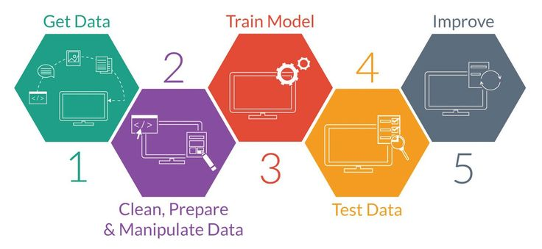
PROPOSED METHODOLOGY
Load and preprocess the dataset, handling missing values and preparing features.Apply Chi-square test for selecting the most relevant features.
Balance the dataset using SMOTE to improve model generalization.
Optimize SVM hyperparameters using the Jellyfish Optimization Algorithm and evaluate the model's performance.

Slide 15

ADVANTAGES OF THE PROPOSED METHODOLOGY
Improved prediction accuracy through effective feature selection and optimization.
SMOTE ensures a balanced dataset, leading to better model generalization.
Jellyfish Optimization enables efficient, automated, and reproducible hyperparameter tuning.

Slide 16



Hardware & Software Specifications
HARDWARE
i3/i5 Processor
4GB+ RAM
Storage: 256 GB
SOFTWARE:
OS: Windows
Google colab
FRAMEWORK:
Scikit-learn, Pandas, NumPy, imbalanced-learn

Slide 17
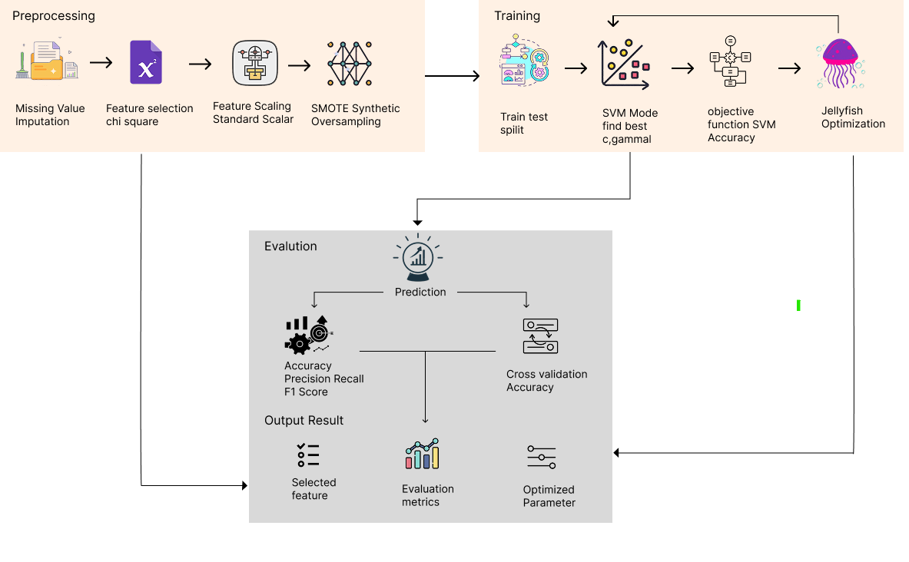
LIST OF MODULES WITH DESCRIPTIONS

Slide 18
LIST OF MODULES WITH DESCRIPTIONS
Data Collection
• Data is sourced from publicly available repositories like UCI Machine Learning Repository and Kaggle.
• The dataset includes attributes such as age, blood pressure, cholesterol levels, heart rate,and other clinical parameters relevant to heart disease prediction.
Data Preprocessing
• Handling Missing Values: Imputation techniques are applied to manage incomplete data.
• Normalization: Scaling techniques ensure consistent feature ranges.
Feature Selection
• The features are selected using size square test.

Slide 19
LIST OF MODULES WITH DESCRIPTIONS
Model Selection
• Machine learning models such as Support Vector Machine (SVM), KNN, and GradientBoosting are considered.
• Hybrid models like SVM-JFO improve prediction accuracy.
Model Evaluation
• Performance is assessed using metrics such as accuracy, precision, recall, F1-score, and ROC curve analysis.
• A confusion matrix is analyzed to determine model effectiveness.

Slide 20
LIST OF MODULES WITH DESCRIPTIONS
Optimization
• Jellyfish Optimization Algorithm (JFO) enhances feature selection and classification accuracy.
• Hyperparameter tuning (Grid Search, Random Search) optimizes model performance.
• Ensemble learning techniques boost predictive accuracy and stability.

Slide 21
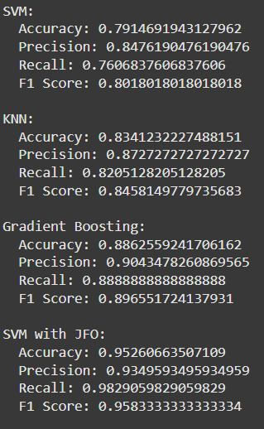
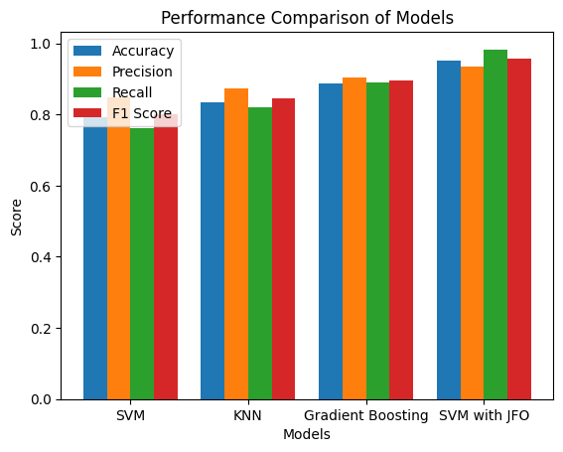
RESULT & DISCUSSION

Slide 22
CONCLUSION & FUTURE SCOPE
The proposed system effectively predicts heart disease using optimized SVM. Feature selection and SMOTE improved model stability. Jellyfish Optimization outperformed manual tuning in achieving better accuracy.
FUTURE SCOPE
Deploy the prediction model through a user-friendly web application for practical use.Validate the model with real-time patient data to assess its real-world performance.
Explore advanced optimization algorithms and incorporate additional health parameters to enhance prediction accuracy.

Slide 23
REFERENCES
Journal
1) Ahmed, Mohammed, and Idress Husien. "Heart Disease Prediction Using Hybrid Machine Learning: A Brief Review." Journal of Robotics and Control (JRC) 5, no. 3 (2024): 884-892.
2) Babu, Ch Kiran, M. Iswarya, R. Manikanta Kumar, And M. Pavan Sai. "Effective feature engineering technique for heart disease prediction with machine learning." Journal of Nonlinear Analysis and Optimization 15, no. 1 (2024).
3) Shankar, Sharmila. "Deep Learning-Based Method for Detecting Parkinson using 1D Convolutional Neural Networks and Improved Jellyfish Algorithms." International journal of electrical and computer engineering systems 15, no. 6 (2024): 515-522.
4) Rizinde, T., I. Ngaruye, and N. D. Cahill. "Machine Learning Algorithms for Predicting Hospital Readmission and Mortality Rates in Patients with Heart Failure." African Journal of Applied Research 10, no. 1 (2024): 316-338.
5) Liu, Tianyi, Andrew Krentz, Lei Lu, and Vasa Curcin. "Machine learning based prediction models for cardiovascular disease risk using electronic health records data: systematic review and meta-analysis." European Heart Journal-Digital Health (2024).
6) Vara, Nidadavolu Venkat Durga Sai Siva, Prasad Raju, and Penmetsa Naveena Devi. "AI-Assisted Medical Imaging and Heart Disease Diagnosis: A Deep Learning Approach for Automated Analysis and Enhanced Prediction Using Ensemble Classifiers." Journal of Artificial Intelligence General science (JAIGS) ISSN: 3006-4023 6, no. 1 (2024): 210-229.
7) Ahmad, M., S. Bani Hani, M. Abu-Abeeleh, and I. Aljarah. Prediction of mortality in young adults with cardiovascular disease using artificial intelligence. Electron J Gen Med. 2024; 21 (3): em584. Electronic Journal of General Medicine, 2024.
8) Bhowmik, Proshanta Kumar, Mohammed Nazmul Islam Miah, Md Kafil Uddin, Mir Mohtasam Hossain Sizan, Laxmi Pant, Md Rafiqul Islam, and Nisha Gurung. "Advancing Heart Disease Prediction through Machine Learning: Techniques and Insights for Improved Cardiovascular Health." British Journal of Nursing Studies 4, no. 2 (2024): 35-50.

Slide 24
REFERENCES
9) Hossain, Md Imam, Mehadi Hasan Maruf, Md Ashikur Rahman Khan, Farida Siddiqi Prity, Sharmin Fatema, Md Sabbir Ejaz, and Md Ahnaf Sad Khan. "Heart disease prediction using distinct artificial intelligence techniques: performance analysis and comparison." Iran Journal of Computer Science 6, no. 4 (2023): 397-417.
10) Alkayyali, Z. K., S. Anuar Bin Idris, and Samy S. Abu-Naser. "A systematic literature review of deep and machine learning algorithms in cardiovascular diseases diagnosis." Journal of Theoretical and Applied Information Technology 101, no. 4 (2023):
1

